Slide 1



AUTOMATIC BOOK PAGE TURNER FOR PARALYZED PEOPLE
TEAM MEMBERS : Lokesh Saravanan GK
Vignesh S
Malavika V
MENTOR : Dr.P.Sivaranjini
1

Slide 2
PROBLEM STATEMENT : “Technological solution for automatic book page turning to facilitate paralyzed people.” OBJECTIVE : The primary objective of the automatic book page turner project for paralyzed individuals is to provide a technological solution that enables individuals with limited or no mobility to independently engage in reading activities. Empower paralyzed individuals to engage in recreational and educational activities independently, reducing their reliance on caregivers or assistive devices for simple tasks like turning book pages.

Slide 3
Solution:
To develop a device that attaches to a wheelchair or bed frame, allowing paralyzed individuals to turn pages independently using Vocal commends or other accessible gestures.
To design the device with customizable interfaces to accommodate various levels of paralysis and sensory abilities. For example, incorporate voice commands or touchscreen controls for users with limited mobility in their extremities.
Implement wireless connectivity (e.g., Bluetooth) to allow seamless communication between the page-turning device and other assistive technologies, such as speech-generating devices or environmental control systems.
Incorporate sensory feedback mechanisms, such as audio or vibration cues, to provide confirmation to users when a page has been successfully turned, enhancing the user experience and independence.
Include adjustable settings for page-turning speed, sensitivity, and other parameters to accommodate individual user preferences and reading habits.
Prioritize simplicity and ease of use in the design of the device to make it accessible to users with diverse abilities and minimize the need for technical assistance.
Collaborate with occupational therapists and end-users throughout the development process to ensure that the device meets the specific needs and preferences of paralyzed individuals and integrates seamlessly into their daily routines.

Slide 4
Hardware details:
Mechanical Page Turning Mechanism:
Servo Motors
Gear Assemblies
Page Grippers
Book Holding Mechanism:
Adjustable Clamp
Page Separator
Control System:
NUCLEO-U575ZI-Q: ARM Cortex M33 with Trust zone / 160MHz / Ultra- low power MCU with FPU/ higher Security
Position Sensors
Communication Modules
User Interface:
LCD display
Audio Feedback – Speaker/Buzzer
Tactile Feedback – Vibration motors
Enclosure and Mounting:
Mounting Options - clamps, brackets, or adhesive pads
Page Detection System:
Optical Sensors
Sensors for Page Jam Detection
Power Supply:
Rechargeable Batteries
Power Management Circuitry

Slide 5
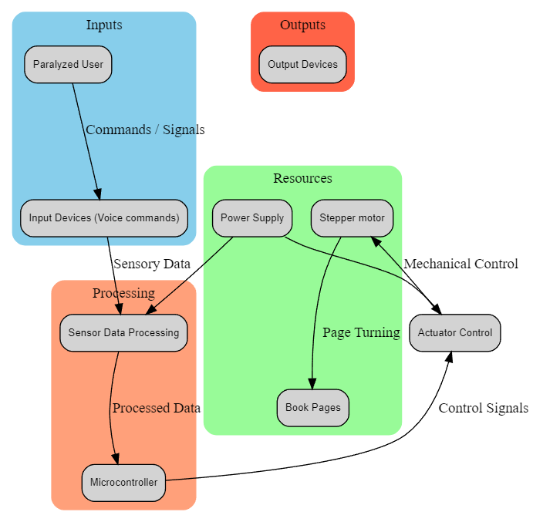

Block diagram:

Slide 6
APPLICATIONS:
Independent Reading: Paralyzed individuals can use the device to turn pages of physical books independently, allowing them to enjoy reading without requiring assistance from caregivers or family members.
Educational Materials: Students with paralysis can use the device to access textbooks and other educational materials, enabling them to study and complete assignments without barriers.
Recreational Reading: The device enables paralyzed individuals to engage in recreational reading, such as novels, magazines, or newspapers, enhancing their leisure activities and mental stimulation.
Therapeutic Activities: Occupational therapists can incorporate the device into therapy sessions to help paralyzed individuals improve fine motor skills, hand-eye coordination, and cognitive abilities through interactive reading exercises.
Accessibility in Libraries: Libraries and community centers can provide the device as an accessibility tool for patrons with paralysis, ensuring equitable access to library resources and promoting inclusion in educational and cultural activities.
Career Development: Paralyzed individuals can use the device to access professional development resources, such as business books, industry journals, and online courses, supporting their career advancement and vocational rehabilitation goals.
Personalized Reading Experiences: The device can be programmed to remember reading preferences, such as font size, page layout, and bookmarking, allowing users to create personalized reading experiences tailored to their specific needs and preferences.
Social Inclusion: By enabling paralyzed individuals to participate in reading-related activities independently, the device promotes social inclusion and fosters connections with peers, caregivers, and community members who share similar interests in literature and learning.

Slide 7
THANK YOU

